Slide 1
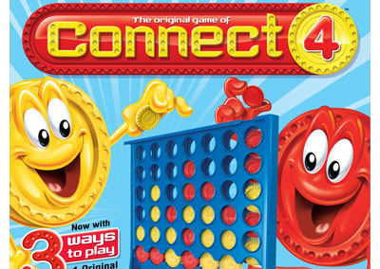
Connect Four AI Project
By Yaw Nimo-Agyare and Sahil Ghelani

Slide 2


Project Topic
Research: Can a Minimax AI with Alpha-Beta Pruning outperform a random or a fixed logic Connect Four opponent efficiently?
Hypothesis: The Minimax algorithm combined with alpha-beta pruning will consistently outperform the basic opponent strategies and will make the optimal decision within a limited computation time

Slide 3
Statement of Project Objectives
Designing and implementing AI in Connect Four
Using Minimax and Alpha-Beta Pruning
The AI will evaluate the performance against different opponents

Slide 4
Approach
Language: Python
Libraries/Tools: Numpy, Matplotlib, Streamlit
Techniques: Minimax Search Algorithm and Alpha-Beta Pruning
Comparisons: Random opponents, potential Greedy opponents

Slide 5
Deliverables
A Connect Four with a functional AI
AI agent using Minimax and Alpha-Beta Pruning
Results of the Experiment using Graphs showing: Win rate, Computation Time, and Depth
Report and GitHub repository

Slide 6
Evaluation Methodology
Win Rate: Percentages of games won against different opponents
Computation Time: The time it took per move
Depth vs Performance: The Effect of Minimax depth on the outcomes of the games

